Slide 1
Best Place for A New Coffee Shop
In the Winston Salem, North Carolina area, where is the best place to open a new coffee shop?

Slide 2

Location is Key For A Coffee Shop
There are many considerations when placing a new business like a Coffee Shop, but the most important is
LOCATION
LOCATION
LOCATION
There are other considerations too, but most business owners will tell you that the most important considerations center around location.
This study looks at the following location data by Zip Code Tablulation Area (ZCTA):
Number of competitors
Population (we need a large market of customers)
Household count (similar to population)
Mean Income

Slide 3

Data Acquisition and Cleansing
ZCTAs within 20 mile radius: We want a location close to the existing business
Foursquare API: to find locations of competition
GeoJSON: for ZCTA boundaries (zipcodes don’t have boundaries)
Census Bureau: population
Census Bureau: Household Count and Mean Income per Household

Slide 4
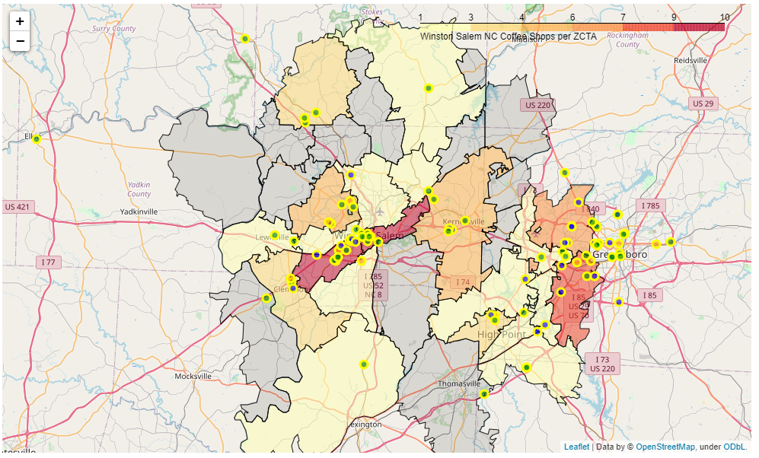
Competition : Shops per ZCTA
Circle Color: Green: Starbucks, Orange: Dunkin’, Grey: Other
ZCTA boundary area colors: darker for more coffee shops per ZCTA (grey = 0)
Note: zipcodes of Coffee Shops approximately align to ZCTA boundaries

Slide 5
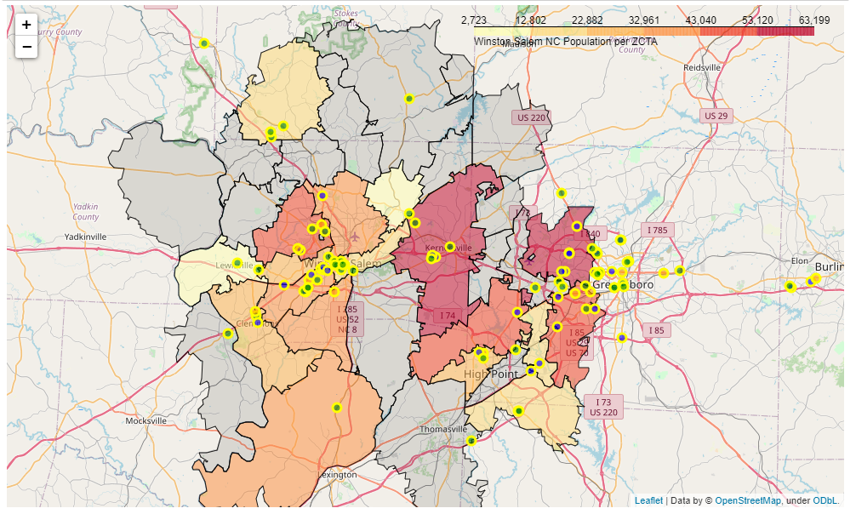
Population PER ZCTA (FOOT TRAFFIC)
Note: Census Bureau query did not provide data for all ZCTAs within a 20 mile radius.

Slide 6
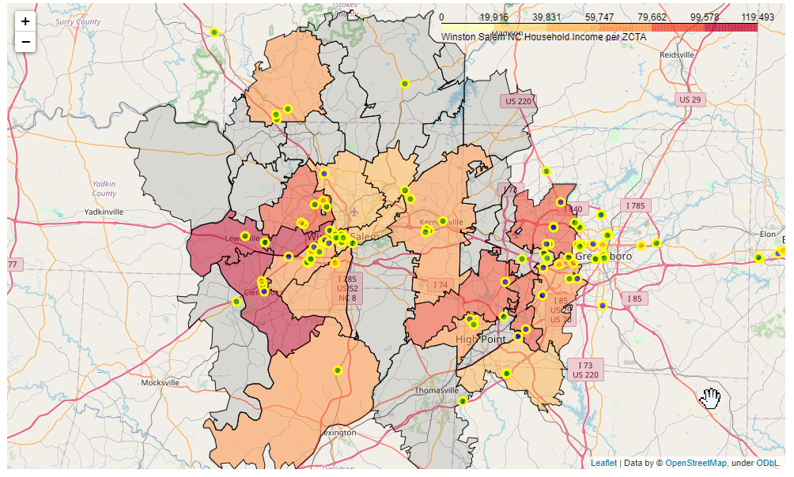
Mean Household Income (Potential Customers)
Note: Census Bureau query did not provide data for all ZCTAs within a 20 mile radius.

Slide 7
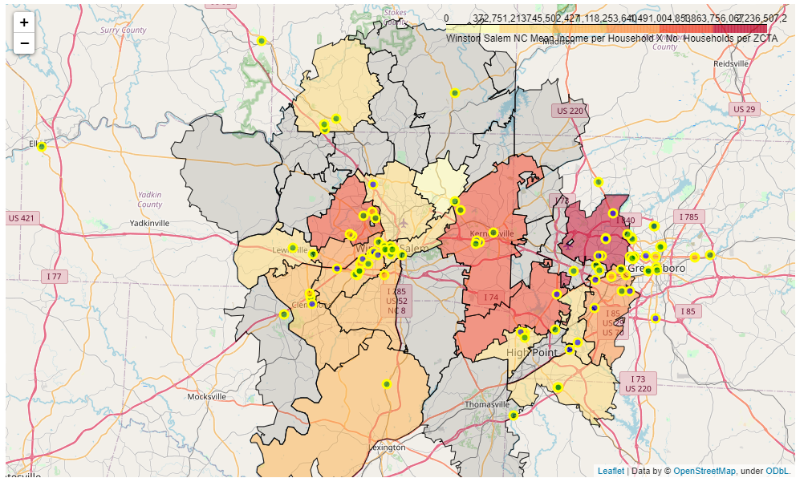
Mean Household Income Times Number of Households
Note: Census Bureau query did not provide data for all ZCTAs within a 20 mile radius.

Slide 8

Conclusion
To determine a good location for a coffee shop in the Winston Salem North Carolina area, the following three aspects were considered:
Competition
Population
Income
Considering these criteria, the following Zip Code Tabulation Areas should be considered when looking for a location:
27265: This ZCTA has lower comptetion and higher population and income
The following ZCTAs are not as desirable but should be considered: 27106, 27284, 27410. It is worth noting that there is at least one Starbucks in each of these areas and 27410 has 6 Starbucks outlets while 27265 only has one.

Slide 9
Future studies
Future data studies for consideration:
Viewing retail rental fees and commitment timeframes
Analyzing foot traffic in the area by looking at Foursquare visits to nearby venues
Analyzing neighborhood cultures for receptivity to a Coffee Shop
Dividing areas into smaller areas for a more concise study
This report prepared 2021-01-27 By Henry Will IV
Twitter: henrywill
Linkedin: http://linkedin.com/in/henrywill4
If you want to connect, please provide a personalized reason

